Slide 1
Vision
Identify the cards on the table
Face Down cards
Face Up cards
Coordinates & Pose Estimation
Match the local coordinates to the world coordinates
Identify the features of the cards
Shape
Rectangle
Triangle
Filler
Shaded
Block
Ellipse
Not Shaded
No of Shapes
1
2
3

Slide 2
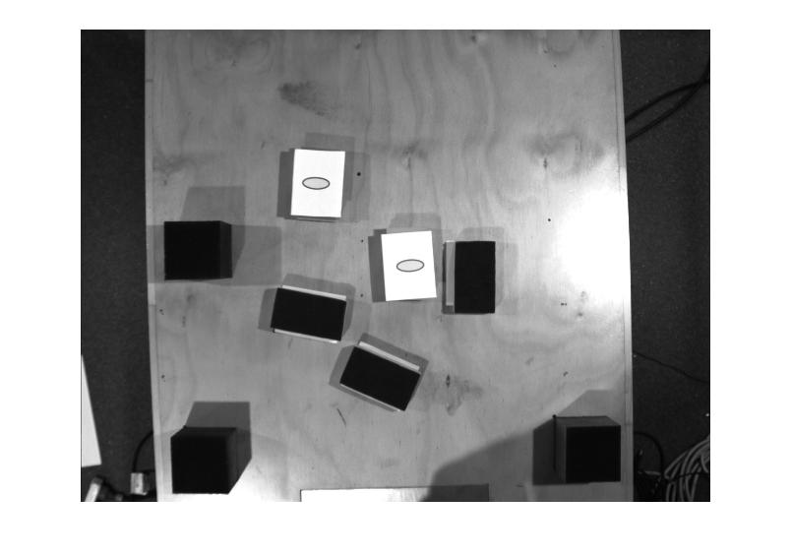
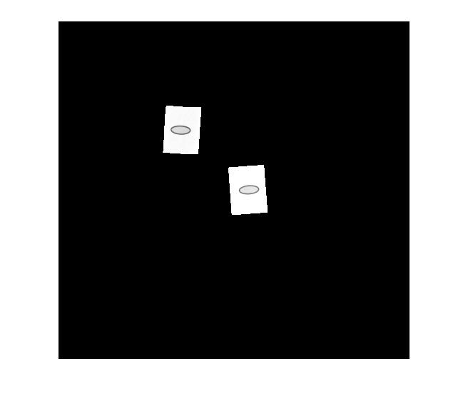
Identify the cards
Used basic histogram equalisation
Used pixel values as a threshold
Create a mask to isolate face up

Slide 3
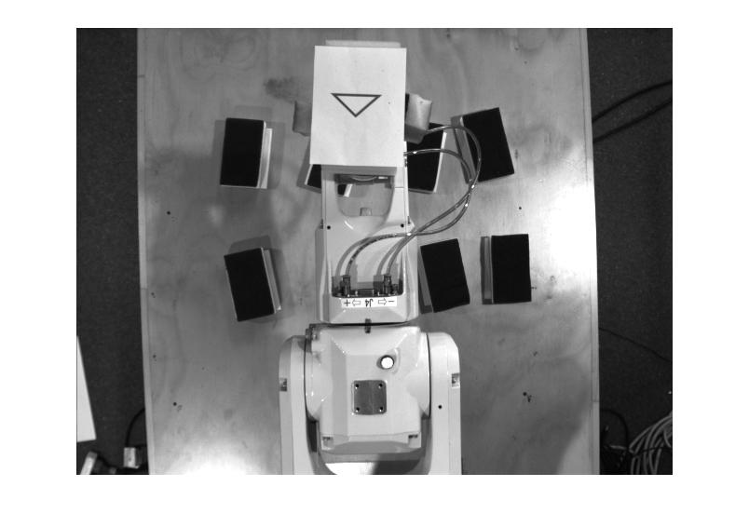
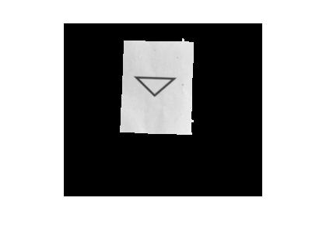
Identify the features of the cards
Create a mask using pixel values for white as a threshold
Extract only the card from the image using a mask and a bounding box

Slide 4
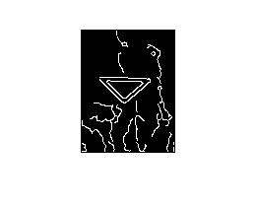

Identify the features of the cards
Detect edges using canny
Remove unnecessary edges from detected edges.
Extract the shape using perimeter value.
Used Mean Intensity for detect the filler status.

